Slide 1
CONVERSATION 2

Slide 2
postage / ˈpəʊstɪdʒ / noun the money charged for sending a letter, package etc by post - It’s yours for £13.99, including postage and packing.

Slide 3
chain / tʃeɪn / noun a number of shops, hotels, cinemas etc owned or managed by the same company or person chain of hotel/restaurant/retail etc chain - a chain of restaurants

Slide 4
minor /ˈmaɪnə / verb to study a second main subject as part of your university degree OPP major minor in something - Sid majored in sociology and minored in political science.

Slide 5
utilize / ˈjuːtəlaɪz, ˈjuːtɪlaɪz / verb to use something for a particular purpose. utilizable adjective utilization /juːtɪlaɪˈzeɪʃən / noun - We must consider how best to utilize what resources we have.

Slide 6
contribute / kənˈtrɪbjuːt / verb to give money, help, ideas etc to something that a lot of other people are also involved in contribute something to/towards something - The volunteers contribute their own time to the project.

Slide 7
enormous / ɪˈnɔːməs / adjective very big in size or in amount SYN huge - The team made an enormous effort .

Slide 8
instrument / ˈɪnstrəmənt, ˈɪnstrʊmənt / noun an object used for producing music, such as a piano or violin SYN musical instrument - brass/wind/percussion/stringed etc instrument

Slide 9
principle / ˈprɪnsəpəl, ˈprɪnsɪpəl / noun a rule which explains the way something such as a machine works, or which explains a natural force in the universe principle of - the basic principles of physics

Slide 10
pamphlet / ˈpæmflət, ˈpæmflɪt / noun a very thin book with paper covers, that gives information about something - a political pamphlet

Slide 11
To get in touch with something make contact with somebody,something (by phone, letter, visit, etc…) Here’s my phone number in case you need to get in touch with me.

Slide 12
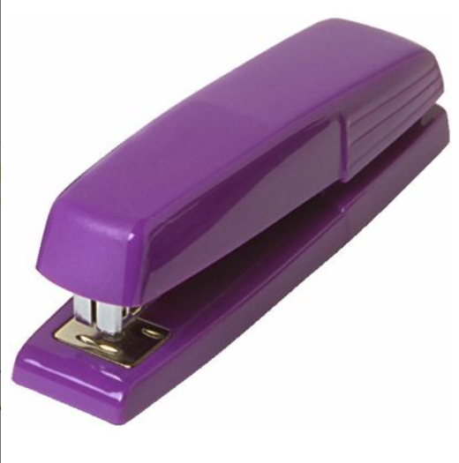
stapler / ˈsteɪplə / noun a tool used for putting staples into paper

Slide 13
To run out of something to finish, use, or sell all of something so that there is none left - I’ve nearly run out of money.

Slide 14
staple / ˈsteɪpəl / noun a small U-shaped piece of metal with pointed ends, used to hold something in place.

Slide 15
confused / kənˈfjuːzd / adjective unable to understand or think clearly about what someone is saying or what is happening - I’m totally confused. Could you explain that again?

Slide 16
navigate / ˈnævəɡeɪt, ˈnævɪɡeɪt / verb to find your way around on a particular website, or to move from one website to another - The magazine’s website is easy to navigate.

Slide 17
interface / ˈɪntəfeɪs / noun the way in which you see the information from a computer program on a screen, or how you type information into the program

Slide 18
release / rɪˈliːs / verb to let news or official information be known and printed SYN publish - The new trade figures have just been released.

Slide 19
accommodation / əkɒməˈdeɪʃən / noun a place for someone to stay, live, or work - living accommodations for the crews

Slide 20
To work (sth) out if a problem or difficult situation works out, it gradually becomes better or satisfactory, and if you work it out, you make it better or satisfactory - Don't worry about anything - it'll all work out (for the best) in the end, you'll see.

Slide 21
amusement park /əˈmjuzmənt pɑ:k/ noun a large park with many special machines where people can go to enjoy games, rides, and other activities

Slide 22
To figure sth/sb out to finally understand something or someone, or find the solution to a problem after a lot of thought - Can you figure out the answer to question 5?

Slide 23
stuff / stʌf / noun used when you are talking about things such as substances, materials, or groups of objects when you do not know what they are called, or it is not important to say exactly what they are - I’ve got some sticky stuff on my shoe.

Slide 24
mileage / ˈmaɪlɪdʒ / noun the number of miles someone travels in a vehicle in a particular period of time - Look for a car hire agreement that offers unlimited mileage.

Slide 25
Potter Mike Judge Karen Chambers Steve Spencer Marcus Sarah Stevenson Beth John Bronson

Slide 26
THANK YOU

